Slide 1
Simple Connect Four Game
By Jordan Wang

Slide 2
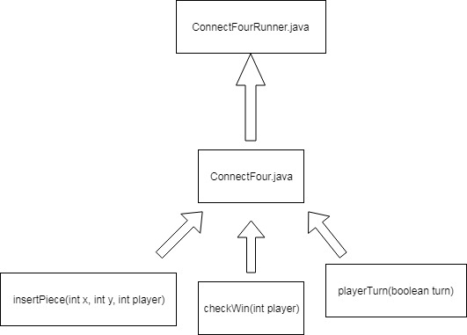
UML Diagram

Slide 3
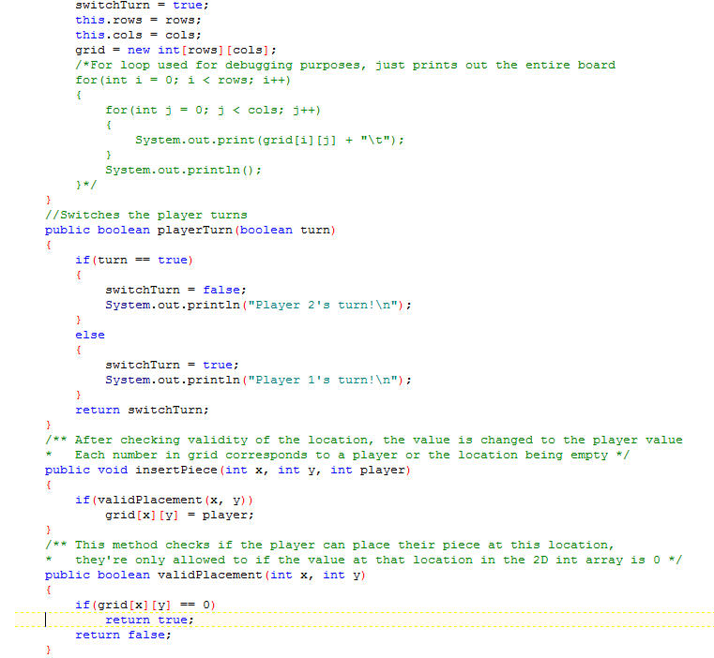
The Object
2D array of ints with 6 rows and 7 columns
Certain ints correspond to each player’s pieces
1 = player 1
2 = player 2
0 = empty
Wanted to make a 2D Button array in the GUI reflect the 2D array of ints in the object

Slide 4
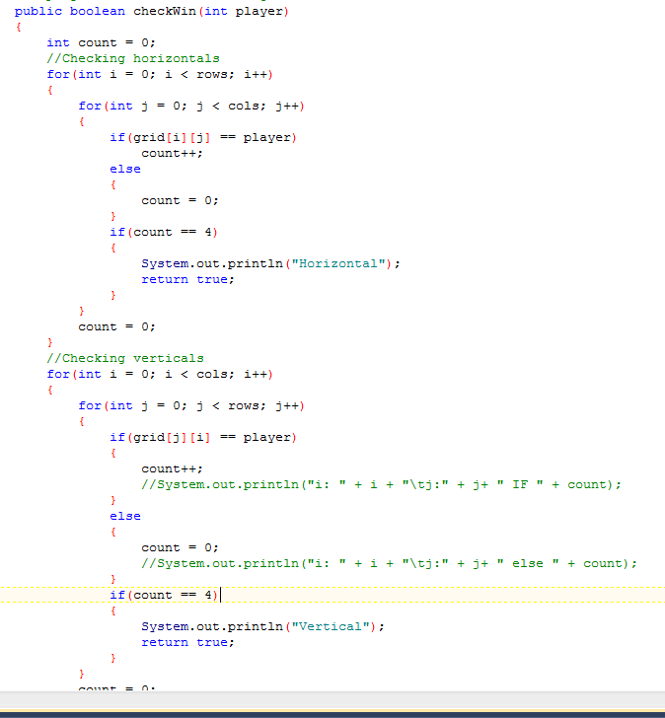
Checking Wins
I just used four for loops for each possible direction a person could win in
For diagonals, I checked if the piece is equal to the parameter, and then the bounds, and finally if the piece diagonal to the parameter is the same
Count represents the number of pieces in a row, reset after each iteration of the outer loop or if the int at the location is not equal to the parameter

Slide 5
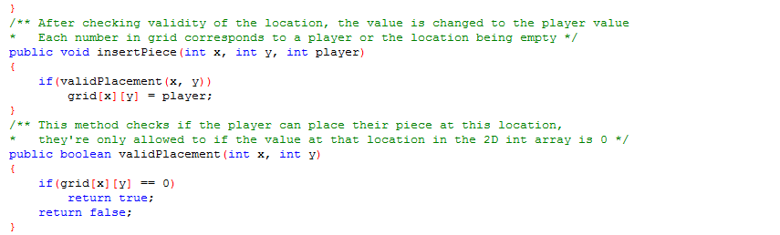
Changing Values in the Grid Array

Slide 6
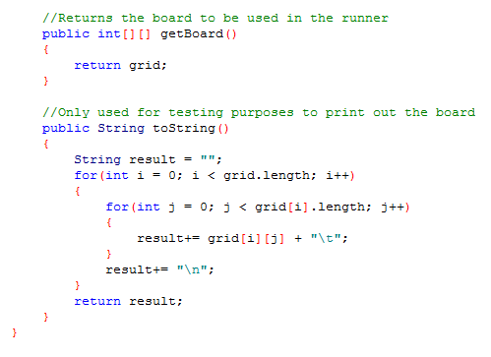
Extra Stuff in the Object

Slide 7
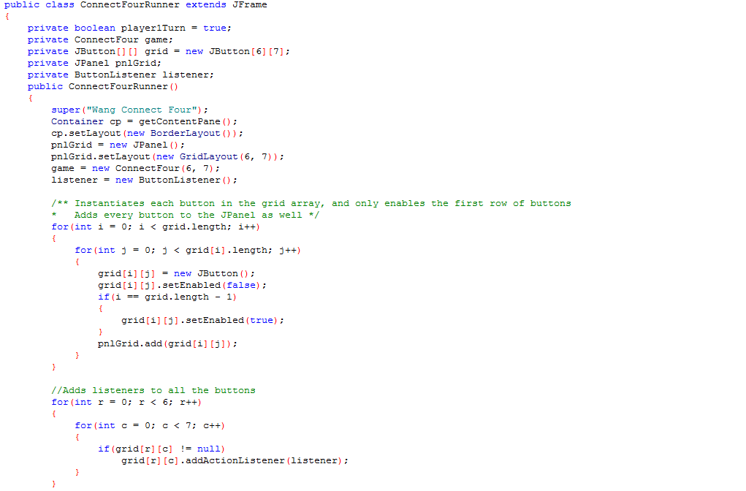
The Runner

Slide 8
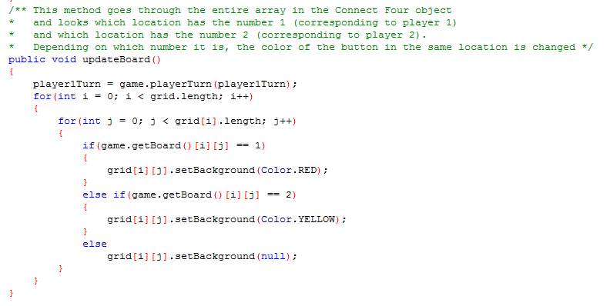
Update Board Method

Slide 9
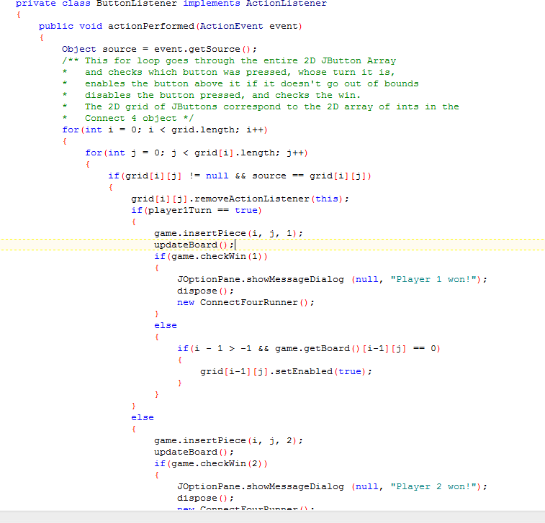
Logic in the Button Listeners

Slide 10
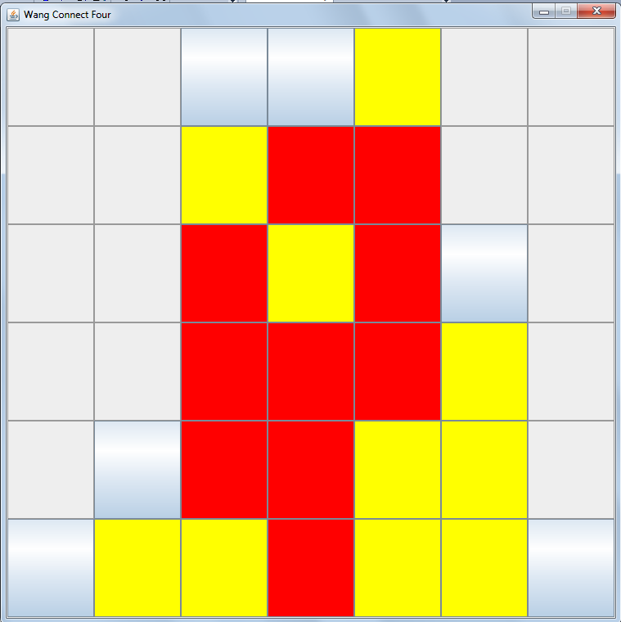
The Product

Slide 11
